Slide 1
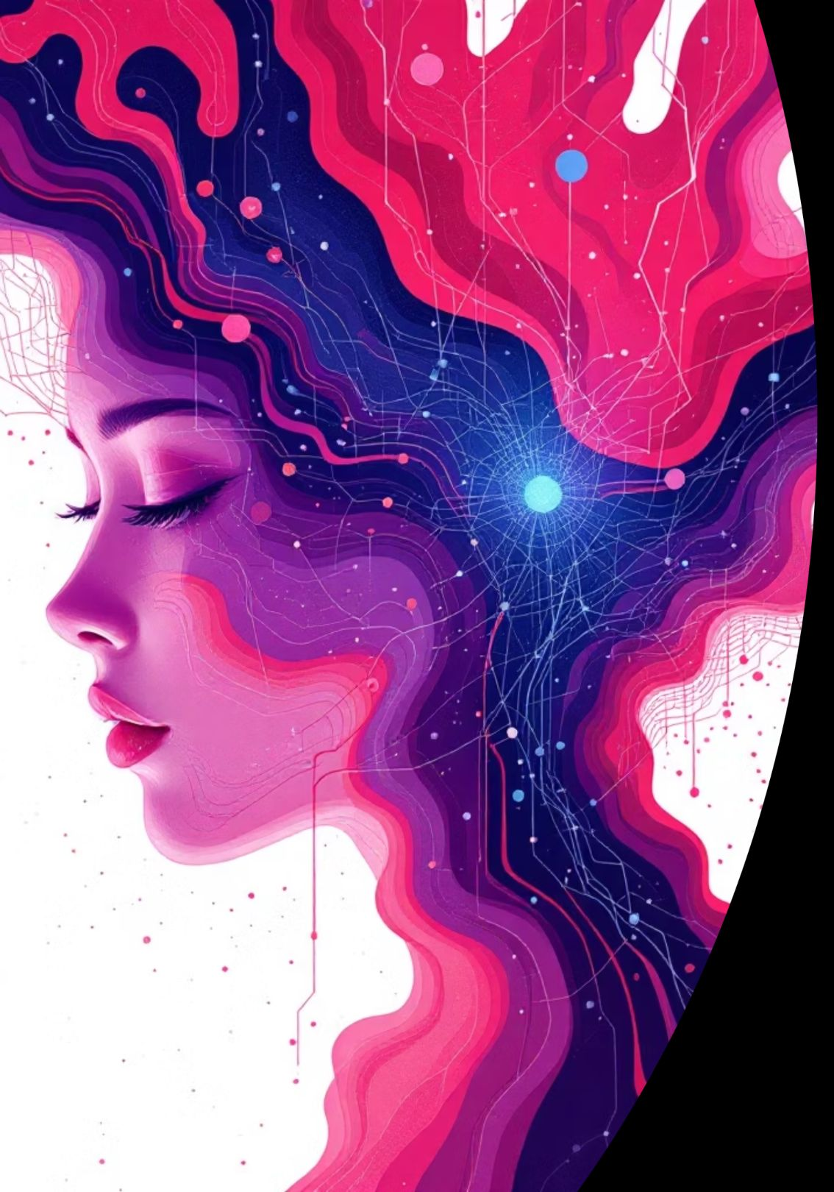
Machine Learning using Python

Slide 2

Introduction to Machine Learning
Machine Learning enables computers to learn from data without explicit programming. ML systems identify patterns, make predictions, and improve through experience.
Fundamental to modern AI technology
Processes massive datasets efficiently
Adapts to new information dynamically
Drives automation across industries

Slide 3

Learning Objectives
Problem Identification
Algorithm Selection
Classify different types of machine learning problems and applications
Apply classification, regression, and clustering algorithms effectively
Model Validation
Neural Networks
Implement cross-validation and performance evaluation techniques
Understand artificial neural network fundamentals and architecture

Slide 4

Types of Machine Learning
1
2
Supervised Learning
Unsupervised Learning
Models trained on labeled data with known outcomes. Used for classification and regression tasks.
Discovers hidden patterns in unlabeled data without predefined answers.
Example: Customer segmentation
Example: Email spam filters
3
Reinforcement Learning
Agents learn through trial and error by receiving rewards or penalties.
Example: Game-playing AI

Slide 5

Python in Machine Learning
Easy Syntax
Clean, readable code that resembles natural language
Strong Community
Active developers providing support and documentation
ML Ecosystem
Rich libraries and frameworks for all ML needs
Industry Standard
Widely adopted by tech companies and researchers

Slide 6
Important Python Libraries
NumPy
Pandas
Powerful numerical computing with N-dimensional arrays and mathematical functions
Data manipulation and analysis with intuitive data structures like DataFrames
Matplotlib
Scikit-learn
Visualization library creating static, animated, and interactive plots from data
Comprehensive ML library implementing classification, regression, and clustering algorithms

Slide 7





Machine Learning Workflow
Data Collection
Gather relevant datasets from multiple sources
Data Preprocessing
Clean, transform, and normalize data for training
Model Training
Fit algorithms to learn patterns from data
Model Evaluation
Test performance using validation techniques
Prediction
Apply trained models to new data instances

Slide 8

Model Evaluation & Validation
01
Train/Test Split
Divide data into training and testing sets
02
Cross-Validation
Use k-fold validation for robust performance estimates
03
Performance Metrics
Calculate accuracy, precision, recall, and F1-score
04
Model Optimization
Adjust hyperparameters to improve results

Slide 9




Real-world Applications
Recommendation Systems
Image Recognition
Fraud Detection
Healthcare Predictions
Computer vision identifies objects, faces, and scenes in photos and videos for security and automation
Financial institutions analyze transactions in real-time to identify suspicious patterns and prevent fraud
Netflix, Amazon, and Spotify use ML to personalize content suggestions based on user preferences and behavior
ML models analyze medical data to predict diseases, recommend treatments, and improve patient outcomes

Slide 10

Course Completion Achievements
Skills Gained
Future Opportunities
Implemented supervised and unsupervised learning algorithms
Built and evaluated ML models using Scikit-learn
Applied data preprocessing and validation techniques
Understood neural network fundamentals
Advance to deep learning and neural networks
Explore specialized applications in NLP or computer vision
Pursue certifications in AI and data science
Apply ML skills to real-world projects
Machine learning is transforming every industry, from healthcare to finance to entertainment. This foundation opens doors to countless career opportunities in the AI era.

